Slide 1
MARKETING & RETAIL ANALYSIS
MILESTONE 2 - VAIBHAV

Slide 2
A Grocery Store shared the transactional data with you. Your job is to identify the most popular combos that can be suggested to the Grocery Store chain after a thorough analysis of the most commonly occurring sets of items in the customer orders. The Store doesn’t have any combo offers. Can you suggest the best combos & offers?

Slide 3
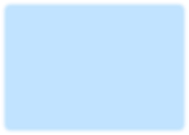
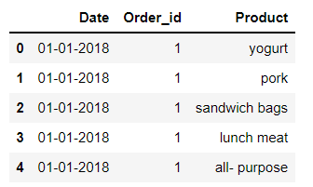
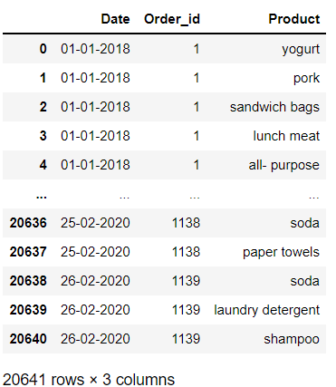
READING THE DATASET

Slide 4


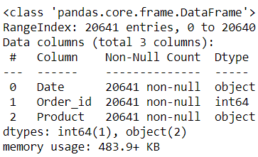
This gives the info of all the columns of the dataset.
The dataset is measured using central measures for all the columns with integer values.
Two columns are of object type, and the rest
is of int type.
It tells how the data is been distributed, deviated or centrally aligned.

Slide 5




Df.shape gives the shape of the dataset that is it gives the total number of rows and columns in the dataset.
The dataset has 20641 rows and 3 columns.
Here we see that the dataset does not have any null values.
If there was any missing values present or any duplicate values, we would have treated it before performing any calculations.

Slide 6

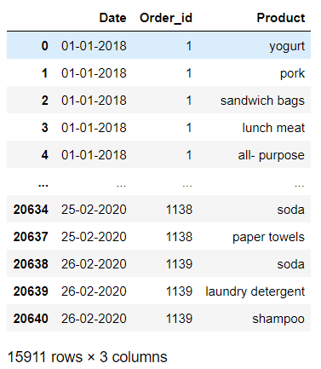


We find there are 4730 duplicate values present in the data set.
The duplicate values are removed.

Slide 7
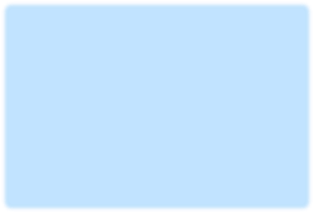
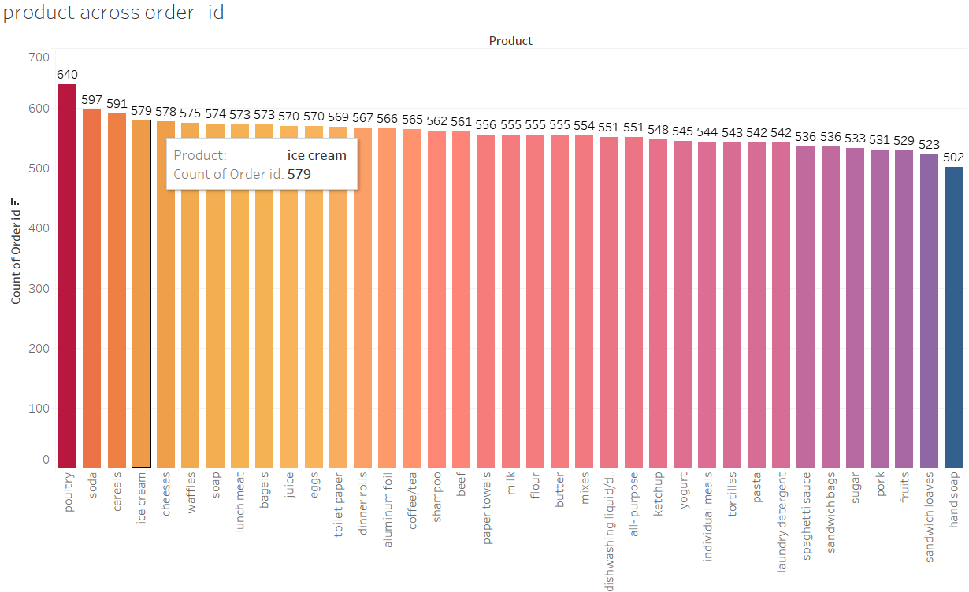
▪ From the chart below we see that Poultry has highest count of orders and followed by soda.
The lowest count of orders is hand soap and second lowest count is sandwich loaves.

Slide 8
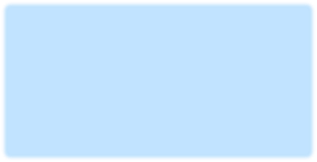
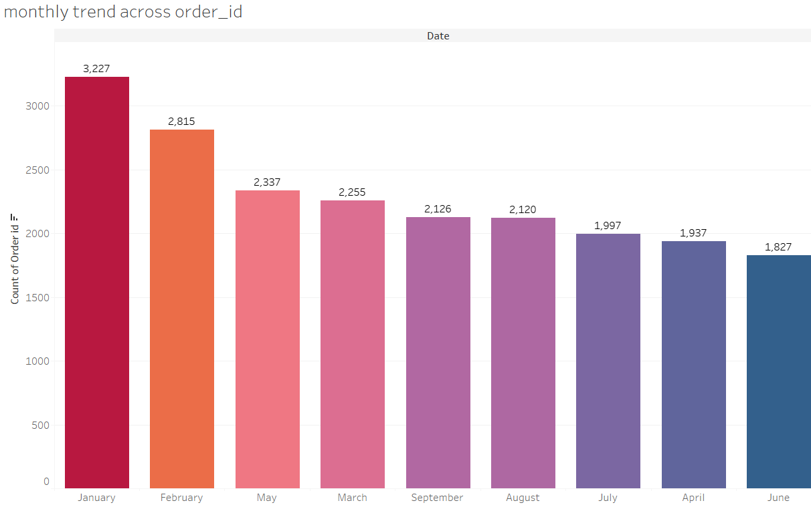
From the chart we see that January month has the highest count of 3227, followed by February 2815.
June month has the lowest count 1827, and second lowest is April 1397.

Slide 9

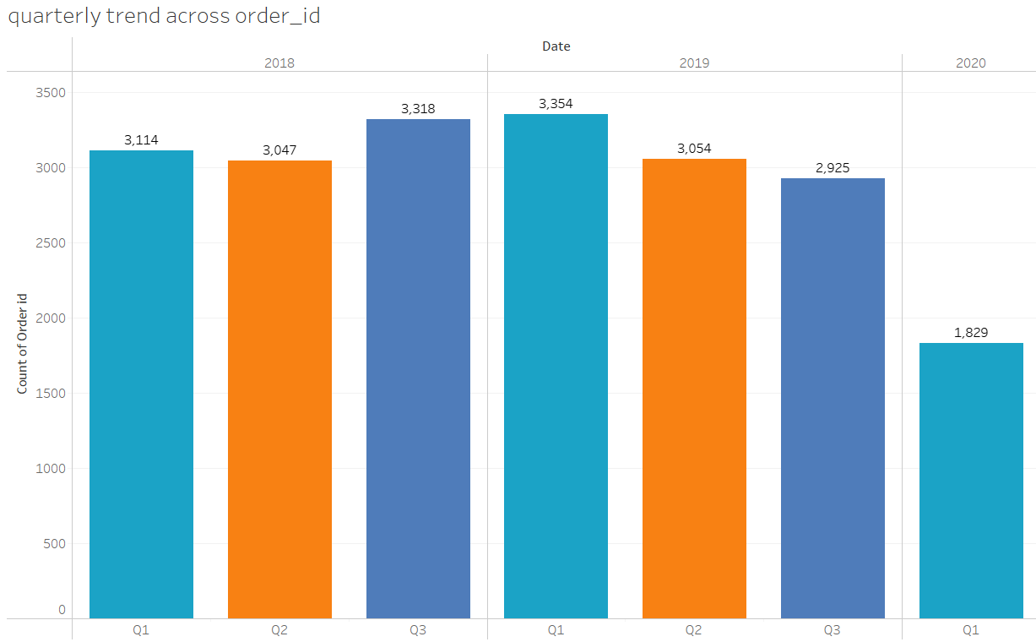
From the chart we see that for the year 2018, 3rd Quarter has the highest count
followed by 1st Quarter then 2nd Quarter.
For the year 2019, 1st Quarter has the highest count followed by 2nd Quarter then 3rd Quarter.

Slide 10

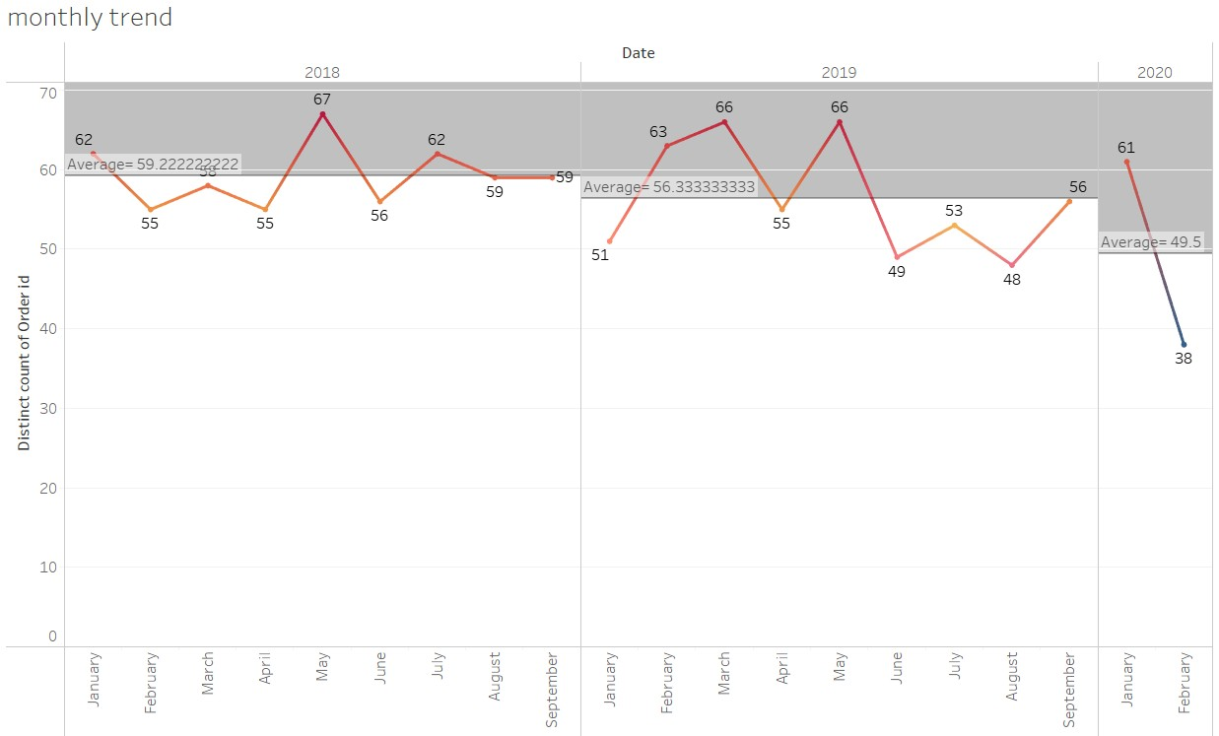
The average value for the year 2018 is 59.222. For the year 2019 is
56.333 and for the year 2020 is 49.5

Slide 11
Market basket analysis is a data mining technique used by retailers to increase sales by better understanding customer purchasing patterns. It involves analyzing large data sets, such as purchase history, to reveal product groupings, as well as products that are likely to be purchased together..
Association Rules are widely used to analyze retail basket or transaction data, and are intended to identify strong rules discovered in transaction data using measures of interestingness, based on the concept of strong rules.
An example of Association Rules
Assume there are 100 customers
10 of them bought milk, 8 bought butter and 6 bought both of them.
bought milk => bought butter
support = P(Milk & Butter) = 6/100 = 0.06
confidence = support/P(Butter) = 0.06/0.08 = 0.75
lift = confidence/P(Milk) = 0.75/0.10 = 7.5

Slide 12

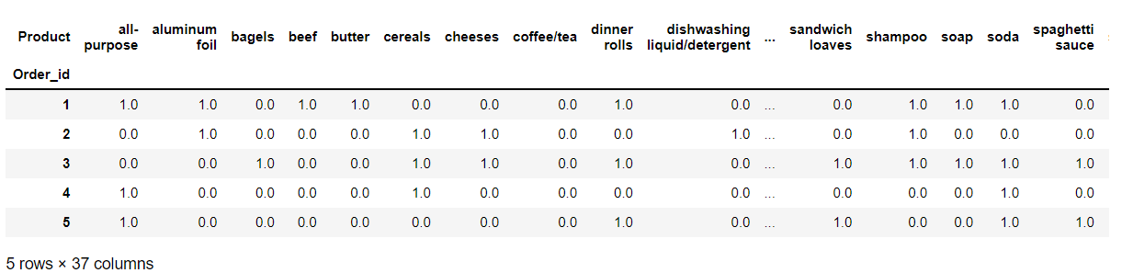
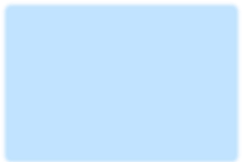
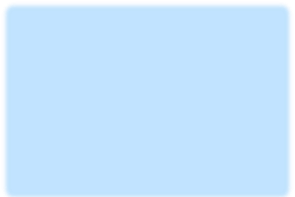
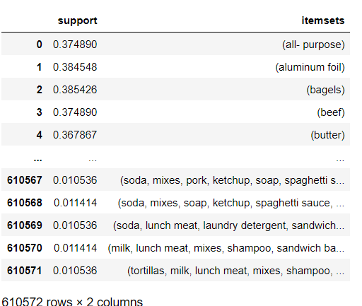
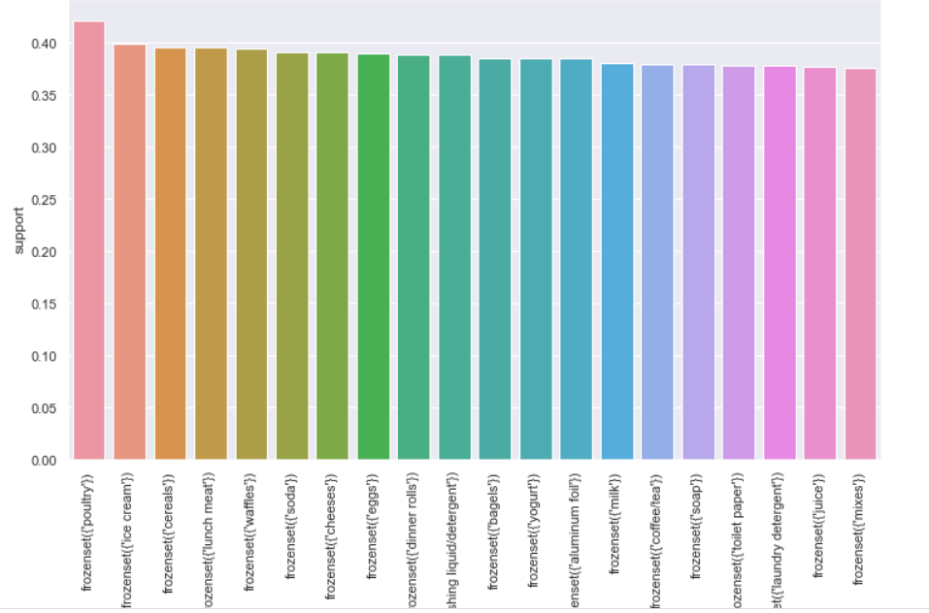

Slide 13
So as we can see in the previous slide the table shows 610572 records in which each row contains a different rules.
It has created multiple rules on the basis of threshold limit that we have set earlier in the Association Rule Learner Node and whichever has a higher lift value we recommend that product to the customer.
Consequent column contains recommended products and we have sorted the lift values from higher to lower for the better recommendations.
MILESTONE 1 - VAIBHAV

Slide 14
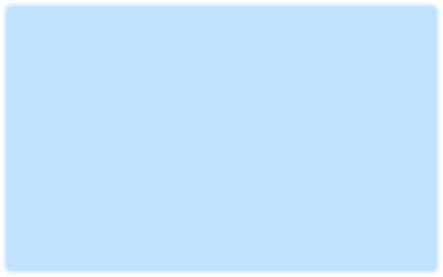
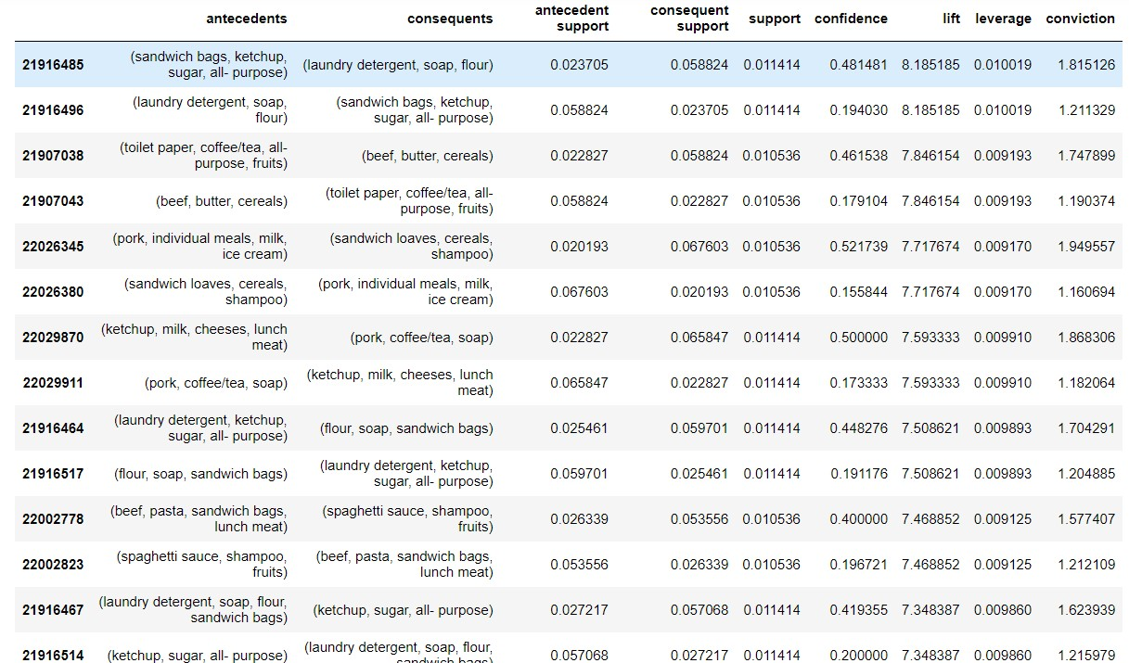
MILESTONE 1 - VAIBHAV

Slide 15
From the above slide we see that the store can provide some combo offers for these products (sandwich bags, ketchup, sugar, all- purpose) and (laundry detergent, soap, flour) as they have good lift.
Same way for (laundry detergent, soap, flour) and (sandwich bags, ketchup, sugar, all- purpose).
The can also provide few discounts offers on combos.
The store can design the discount offers and combos. The above discount % are just an example.

Slide 16
Jupyter Notebook-
Vaibhav_MRA _Project2.ipynb
Tableau Workbook-
https://public.tableau.com/views/MRA_Project_2_16332837128560/productacrossorder_id?:language=en-US&:display_count=n&:origin=viz_share_link

